Slide 1
Local LLMs in Action: Automating CTI to Connect the Dots
Kai Iyer

Slide 2
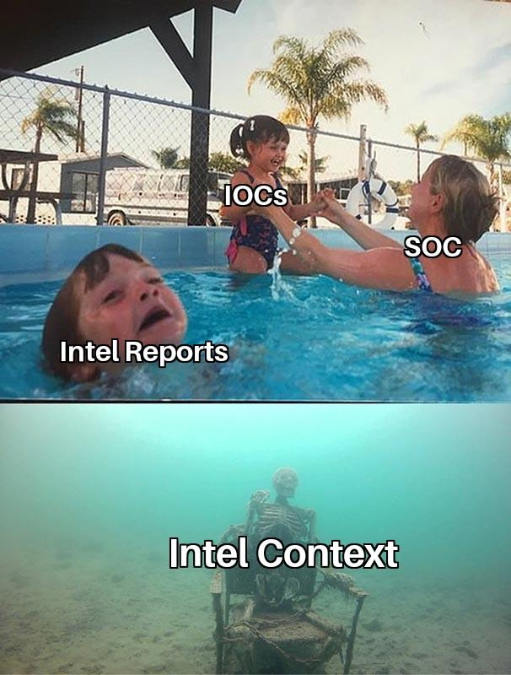
Agenda
whoami
Current CTI Challenges
A quick introduction to LLMs
Why Local LLMs?
From OSINT to Actionable Intelligence
Visualizing Threat Landscape
Navigating the Pitfalls
Takeaways & References

Slide 3
whoami /priv
Kai Iyer
Security Engineer, Amazon
Dev, Blog, Opensource, Privacy
Marathon, Anime & Manga
find me @kaiiyer

Slide 4
Disclaimer
The views, opinions, and content presented in this presentation are solely my own and do not reflect the views, policies, or positions of my employer or any affiliated organizations. This presentation is based on my personal research, experiences, and perspectives and should not be interpreted as an official statement from my employer.
For informational purposes only—use your own discretion when applying any insights shared.

Slide 5
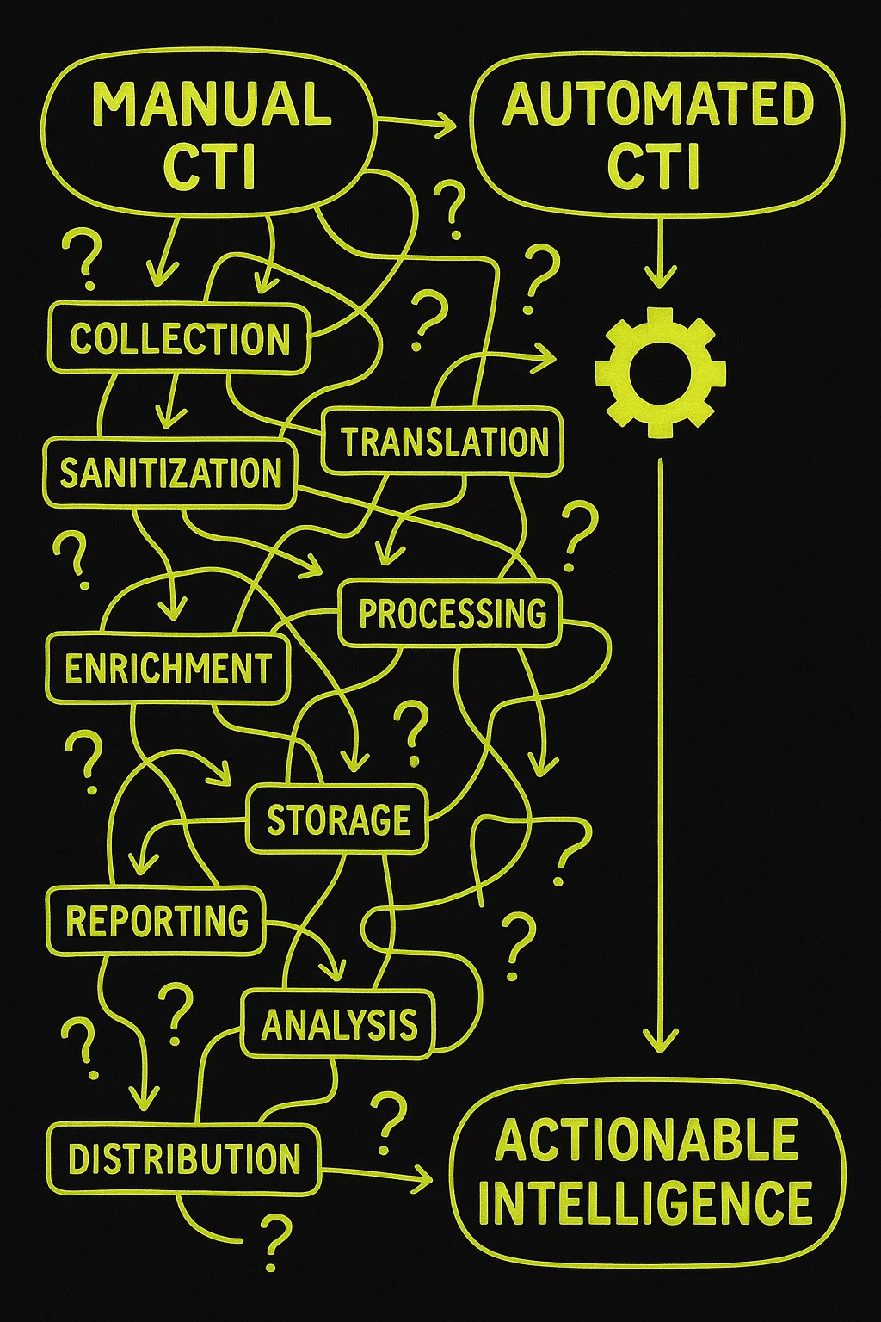
Current CTI Challenges
CTI teams drown in tweets, reports, alerts while threats evolve faster
Volume Overload: 10K+ new IOCs daily
Speed Gap: Manual TTP extraction takes hours but attackers won’t wait
Inefficient Threat Attribution: Linking IOCs to APTs or campaigns is error-prone
Lack of Prioritization: Most CTI feeds are not tailored to your business

Slide 6
A quick introduction to LLMs
A language model is a machine learning model that aims to predict and generate plausible language
These models work by estimating the probability of a token or sequence of tokens occurring within a longer sequence of tokens
Parameters are weights model learned during training, used to predict the next token in the sequence
"Large" can refer either to the number of parameters in the model, or the number of words in the dataset
Notes:
(e.g. Autocomplete)

Slide 7
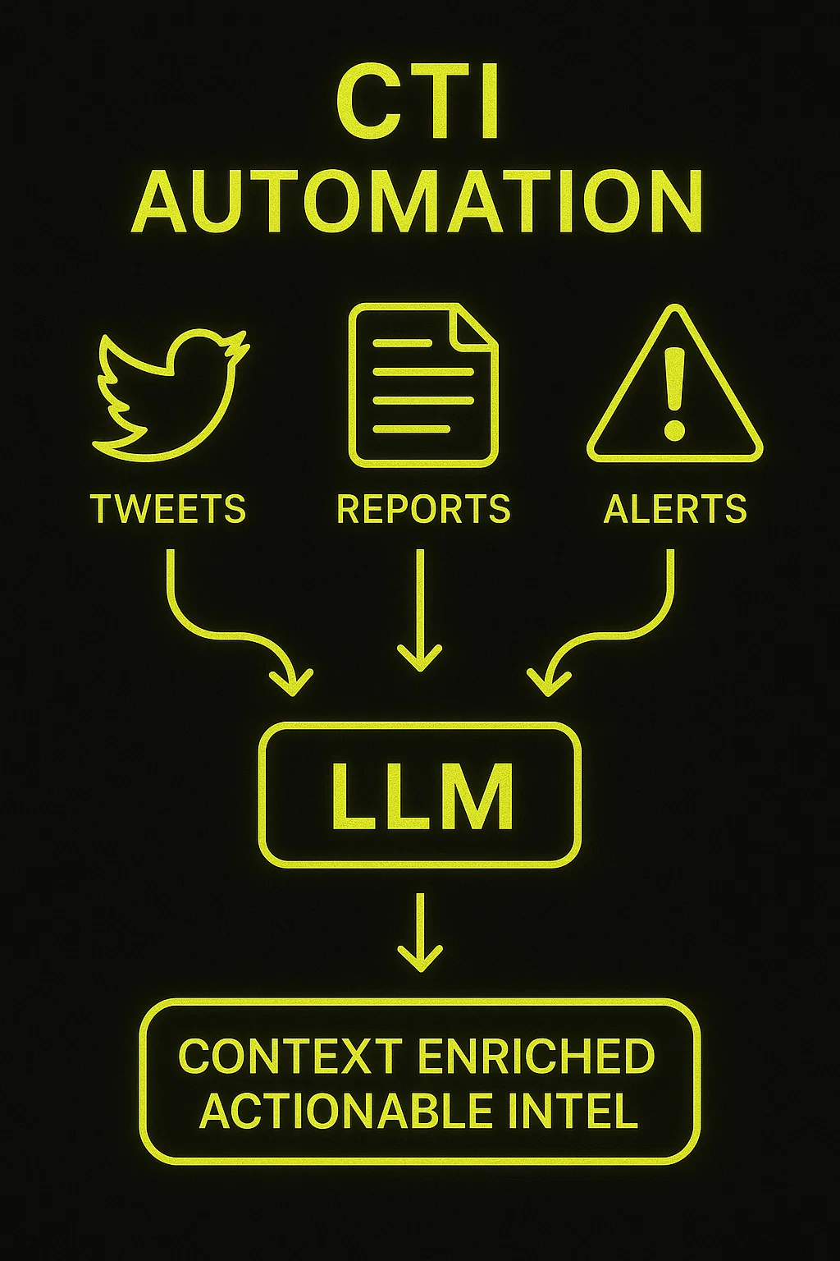
Why Local LLMs?
Process sensitive reports offline and maintains privacy
No vendor lock-in or external data leakage
Train CTI specific models to recognize TTPs, malware families, and APTs
Analyze streaming feeds (e.g., Twitter, CERT alerts) in real-time
Faster iteration cycles and end-to-end automation

Slide 8
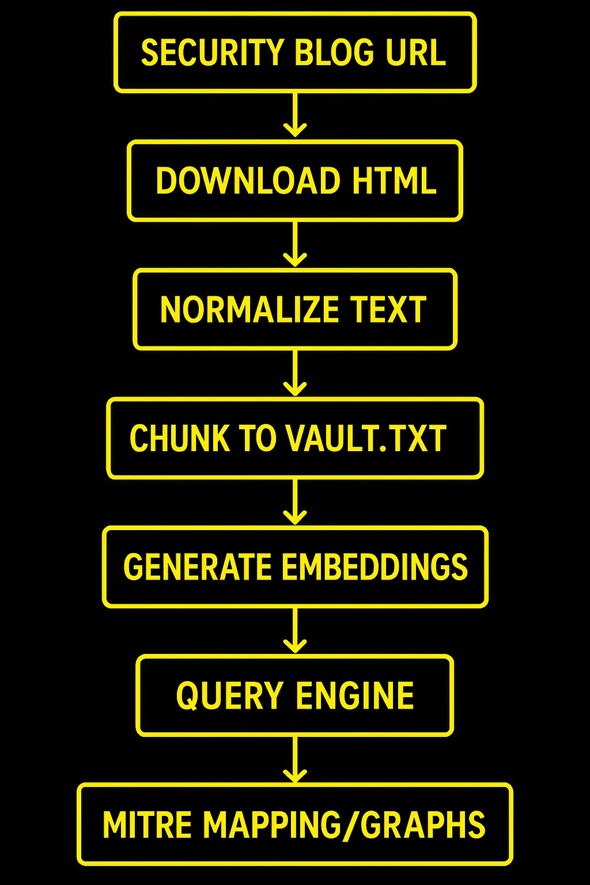
Data Flow
Ingest Intel Report
Normalize & Chunk
Embed & Cache
Query & Visualize

Slide 9


Chunking methods
Fixed-size chunking
Content-aware chunking:
Sentence splitting
Recursive Chunking
Specialized chunking
Semantic Chunking
Photo by Darius Otelea on Unsplash

Slide 10

From OSINT to Actionable Intelligence
1. Scrape & Ingest
Input Sources: Security blogs (DFIR Report, BleepingComputer, Hacker News)
Targets only relevant content (article bodies, titles)
Handles each blog’s unique structure automatically
Output: Clean text with metadata
2. Normalize & Chunk
Text Cleaning: Remove ads/navigation, extract body text
Chunking: Splits articles into token segments
Storage: Lightweight database of centralized text vault with version tracking
Photo by Glen Carrie on Unsplash

Slide 11
From OSINT to Actionable Intelligence
3. Embed & Cache
Generates semantic fingerprints of all content
Stores as embeddings.pt for fast retrieval
Processes only new content to save resources
Uses hash.pid as change tracker
4. Query & Visualize
Natural language questions about threats
Context-aware responses with sources
IOCs/TTPs → MITRE ATT&CK mapping
Threat vector timelines in SIEM
Photo by Glen Carrie on Unsplash

Slide 12
Diving into Demo
Enough slides, show me the actual stuff!!!

Slide 13
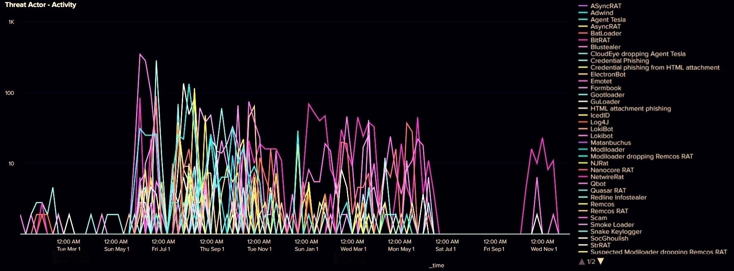
Threat Landscape

Slide 14
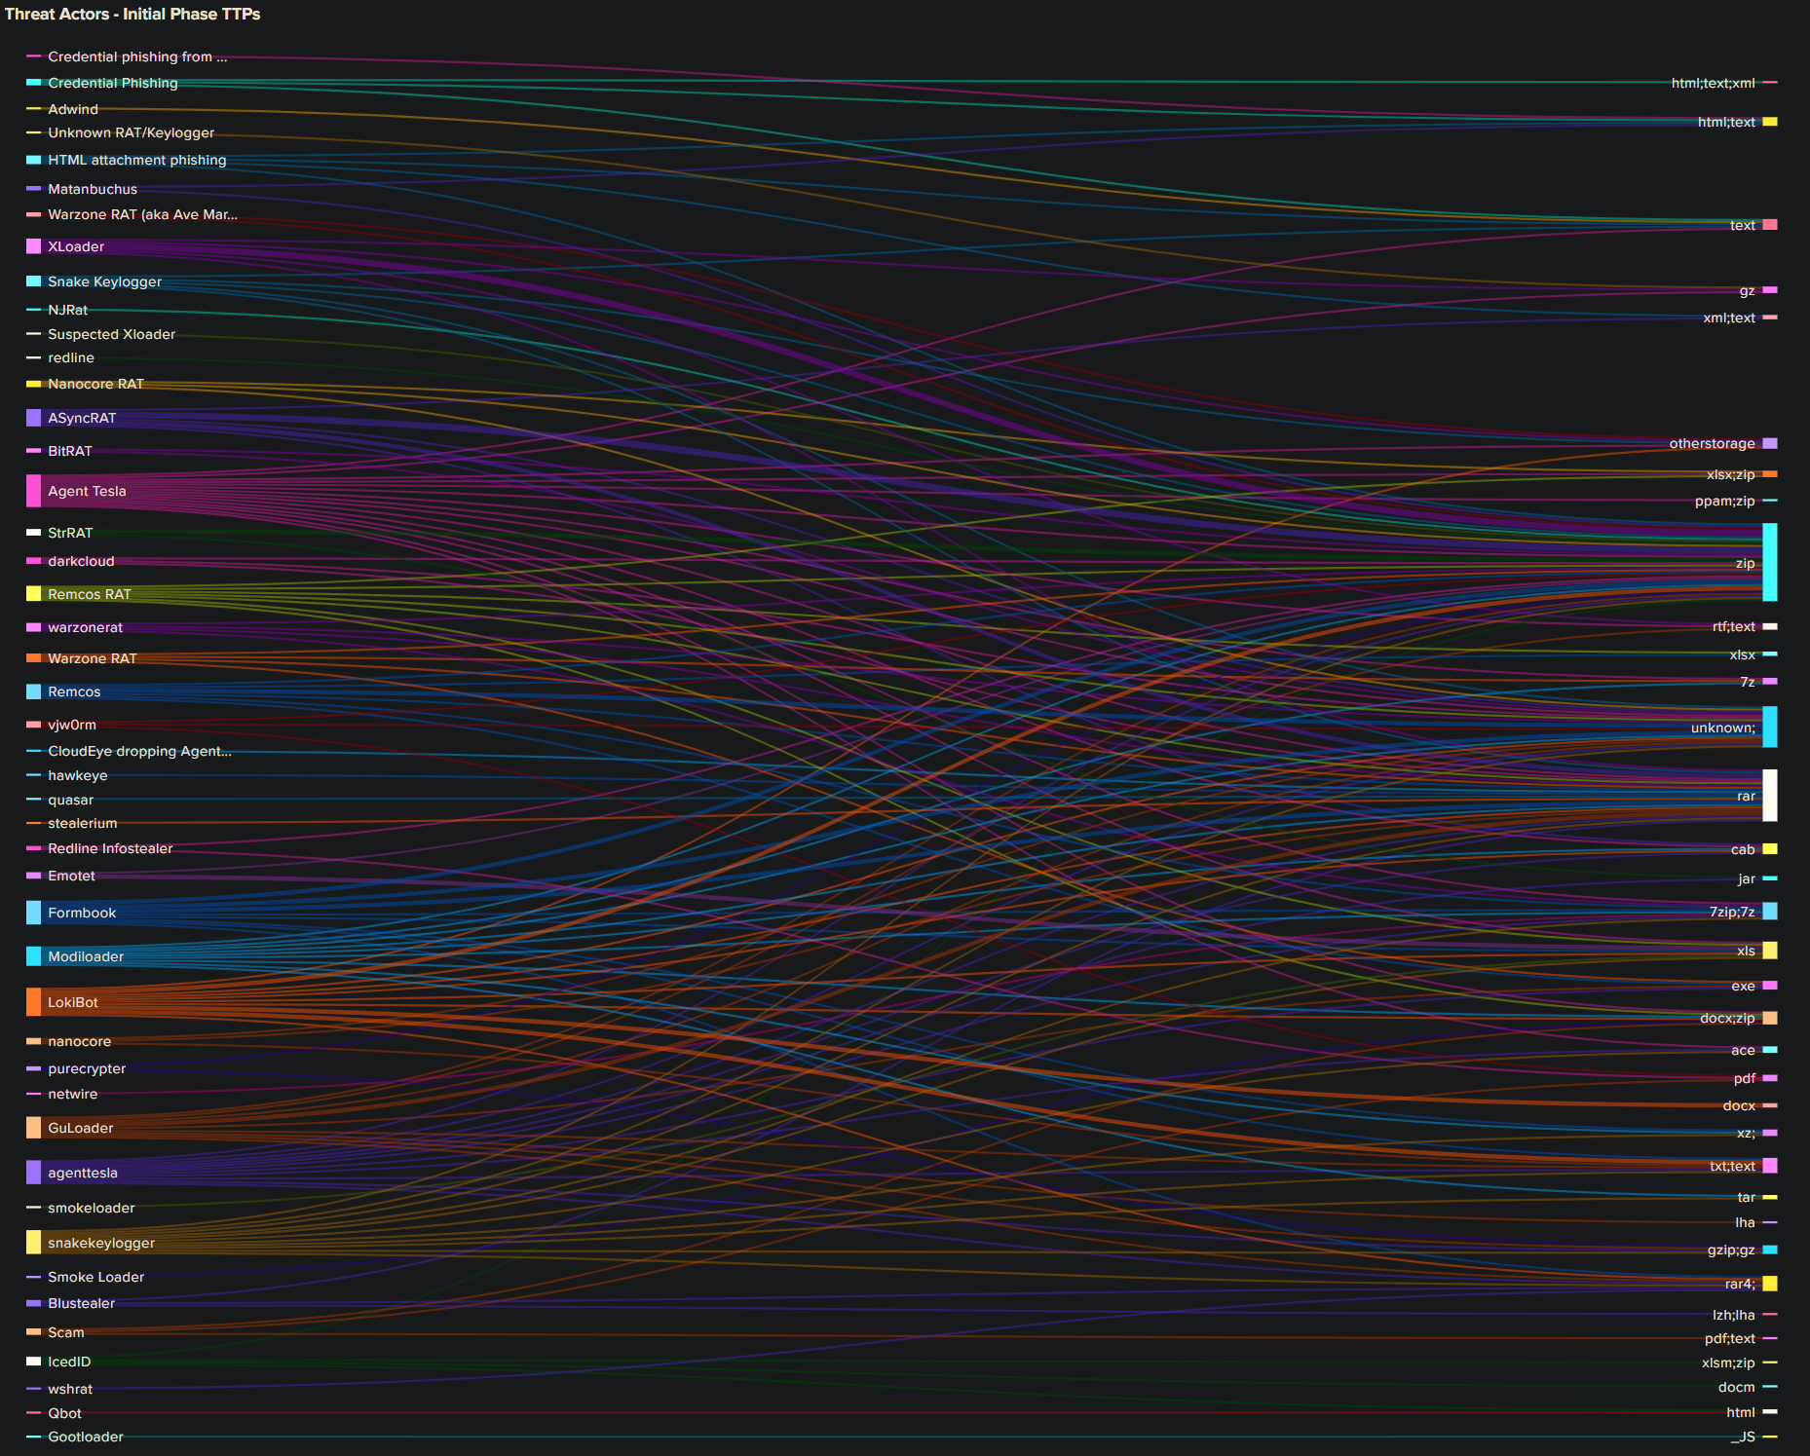
Threat Landscape

Slide 15
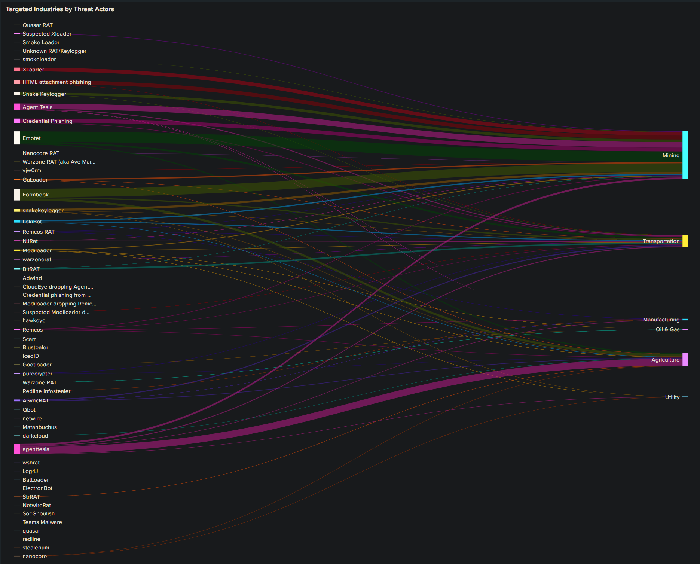
Threat Landscape

Slide 16

Navigating the Pitfalls
Common Issues & Mitigations
LLM Hallucinations → Prompt engineering + Validation scripts
Bias in Training Data → Cross-check with OSINT feeds
Resource Limits → Quantize models (GGUF for CPU-only)
Tool Fragility → Modular code (fallback to regex if LLM fails)

Slide 17
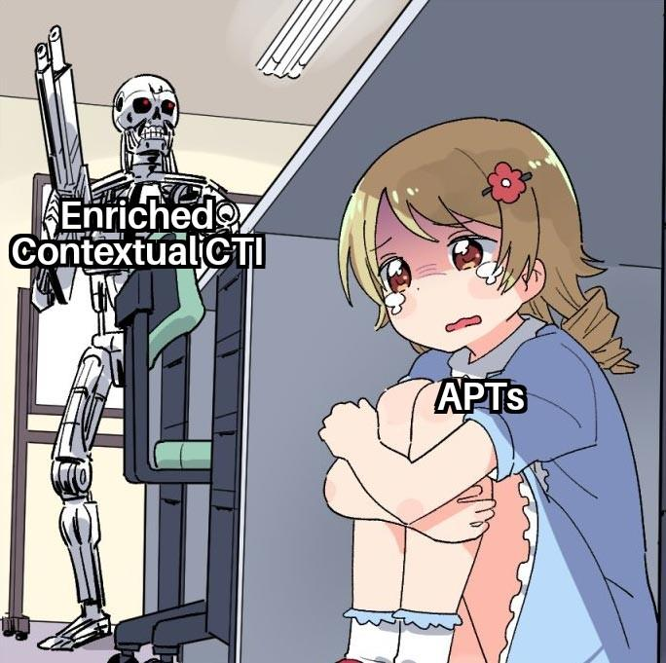
Takeaways
Challenges faced by CTI teams
Fundamentals of LLMs
How LLMs can enhance CTI workflows
Visualizing Threat Landscape
Common Issues & Mitigations

Slide 18

Questions?

Slide 19
References
https://developers.google.com/machine-learning/resources/intro-llms
https://www.linkedin.com/pulse/cti-without-context-just-noise-meet-perisai-indra-tujpc
https://www.pinecone.io/learn/chunking-strategies
https://huggingface.co/sentence-transformers
https://mistral.ai/news/announcing-mistral-7b
https://ollama.com/library/mistral
https://blog.schogini.com/html_files/Embeddings-and-Chunking-Concepts-and-Differences.html

Slide 20
Thank You

